Slide 1
Exam 70-777 Implementing Microsoft Azure Cosmos DB Solutions
Partition and Model Data
Replicate Data Across the World
Tune and Debug Azure Cosmos DB Solutions
Perform Integration and Develop Solutions
https://www.microsoft.com/en-ie/learning/exam-70-777.aspx
Notes:
20533D
1: Introduction to Microsoft Azure

Slide 2
Perform Integration and Develop Solutions
Develop applications with the SQL API
Migrate from MongoDB to MongoDB API in Cosmos DB
Implement event-driven applications by using Azure functions, triggers and Cosmos DB change feed
Analyze Cosmos DB data with Apache Spark connector

Slide 3
Perform Integration and Develop Solutions
Develop applications with the SQL API
Optimize SDK and concurrency control; Tune request options for CRUD and queries; examine response headers; implement optimistic concurrency control with ETAG; query geospatial data; use advanced SQL query operators for complex documents (nested objects and arrays); perform intra-document JOINs; perform SQL queries; implement user-defined functions; use multi-record transactions with stored procedures; implement a continuation model for bounded execution with stored procedures; implement server-side logic and transactions
Migrate from MongoDB to MongoDB API in Cosmos DB
Choose appropriate tools to migrate data; transfer data
Implement event-driven applications by using Azure functions, triggers and Cosmos DB change feed
Use Cosmos DB triggers for Azure functions; change feed mechanics
Analyze Cosmos DB data with Apache Spark connector
Set up and configure a Cosmos DB Spark connector; push down predicates
https://www.microsoft.com/en-us/learning/exam-70-777.aspx
Notes:
The following topics are not included in this presentations due to time constrains
Optimize SDK and concurrency control; Tune request options for CRUD and queries
examine response headers; implement optimistic concurrency control with ETAG
implement server-side logic and transactions

Slide 4
Develop applications with the SQL API
Optimize SDK and concurrency control
Tune request options for CRUD and queries
Examine response headers
Implement optimistic concurrency control with ETAG
Query geospatial data
Use advanced SQL query operators for complex documents (nested objects and arrays)
https://www.microsoft.com/en-ie/learning/exam-70-774.aspx

Slide 5
Develop applications with the SQL API Continue
Perform intra-document JOINs
Perform SQL queries
Implement user-defined functions
Use multi-record transactions with stored procedures
Implement a continuation model for bounded execution with stored procedures
Implement server-side logic and transactions
https://www.microsoft.com/en-ie/learning/exam-70-774.aspx

Slide 6

SQL (DocumentDB) API

Slide 7
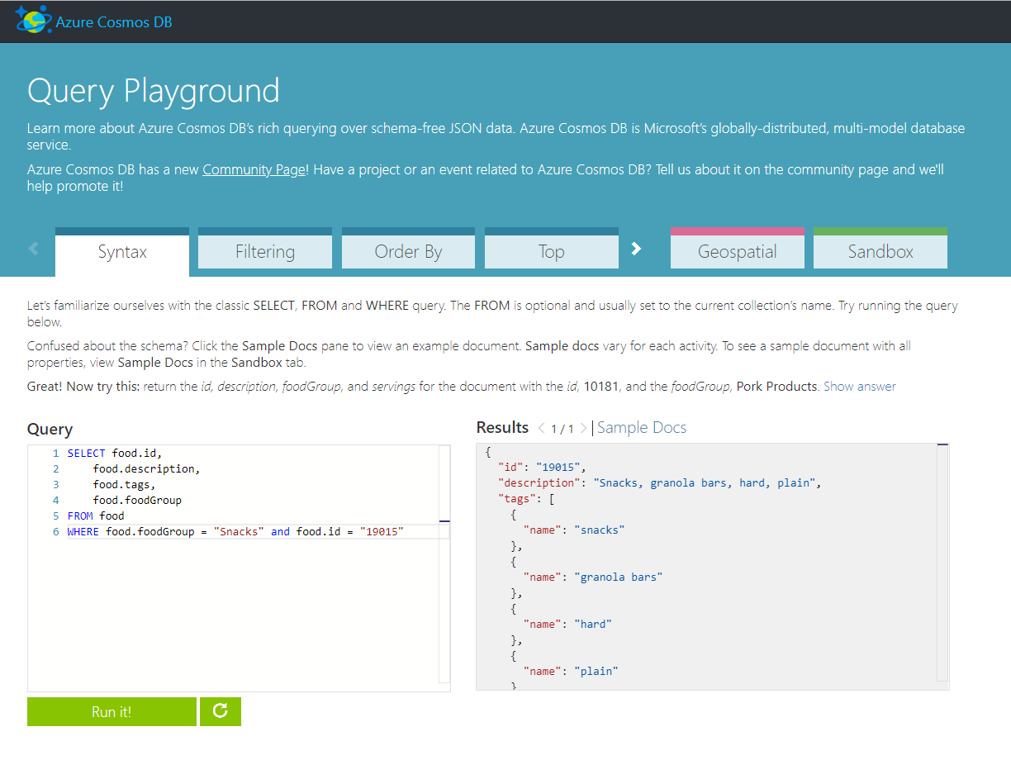
Query Playground
https://www.documentdb.com/sql/demo

Slide 8
Query Demo
Perform SQL queries
Perform intra-document JOINs
Query geospatial data
Use advanced SQL query operators for complex documents (nested objects and arrays)
https://www.documentdb.com/sql/demo

Slide 9
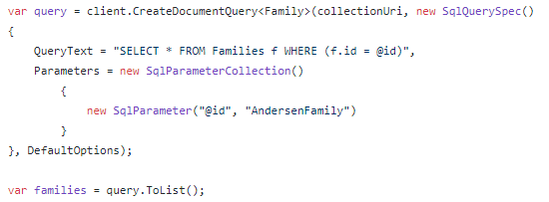
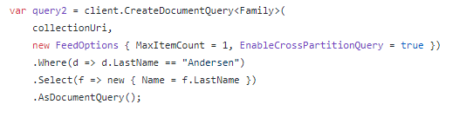
DocumentDB (SQL) API
Example: SQL Parameterization
Example: LINQ
https://docs.microsoft.com/en-us/azure/cosmos-db/sql-api-sql-query
Notes:
Why we call it DocumentDB API?
The first one, was aligned more and more with it
Why query.Tolist() can be a problem?
It built in and goes thru all pages

Slide 10
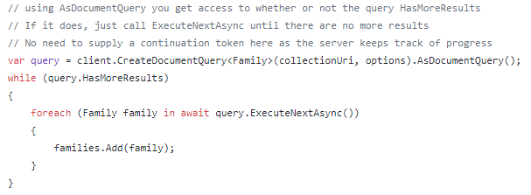
DocumentDB (SQL) API
Query Results are paginated:
ToList() automatically iterates through all pages:
Notes:
You want to run it in a specific page sizes.
And call it to get another page

Slide 11
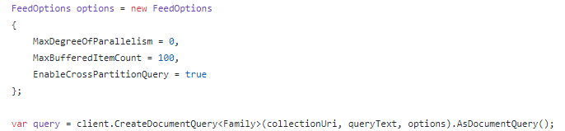
DocumentDB (SQL) API
Cross-Partition Queries
Notes:
Some feed options when running queries
How many partition to hit at the same time from local threads
Buffereditemcount: how many item I can buffer in memory
Crossparitionquery: is it okay to send query is fanned out to every machine or reject it because it is not scalable operation

Slide 12
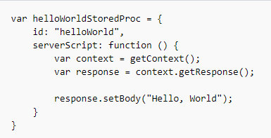
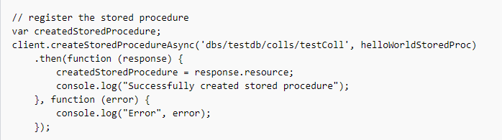
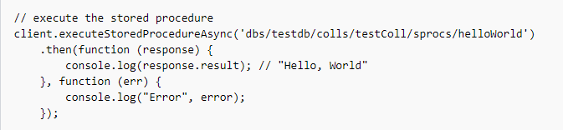
Stored procedures
https://docs.microsoft.com/en-us/azure/cosmos-db/programming
Notes:
Stored Procedures allow you to encapsulate procedural logic as JavaScript code and execute it server-side on your Azure Cosmos DB data. With direct access to documents using the JavaScript API, you can write complex business logic in an encapsulated block of code and run it entirely server-side. This can help you save on bandwidth and other transmission costs often associated with ad-hoc queries over network connections.
transactions are scoped to a single partition key.
In the client-side application,
if you're operating on a partition collection, what you'll wanna do is
you wanna plug in the partition key value into the request options.
And then also make sure that in the stored procedure body that
you only touch documents scoped to that partition.
Otherwise, you're gonna get an exception, and that's not good.
But the reason why I bring this up is that if you have transactional
requirements across multiple documents, you're really gonna wanna
JavaScript is really a full-blown programming language, and this allows you to write very, very rich business logic.
The other thing is it's quite ubiquitous.
It's a well-understood language, and
there's a very large ecosystem of libraries.
And so you can embed JavaScript libraries.

Slide 13
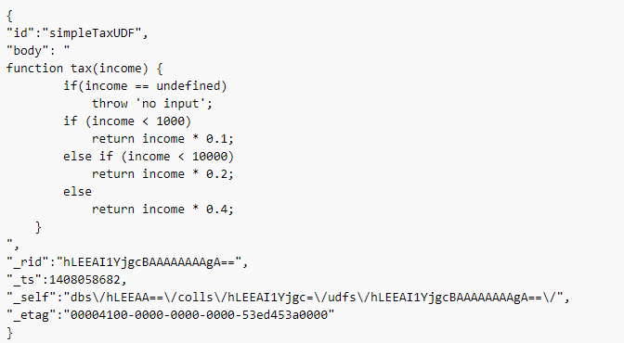
User-Defined Functions
https://docs.microsoft.com/en-us/rest/api/cosmos-db/user-defined-functions
Notes:
A user-defined function (UDF) is a side effect free piece of application logic written in JavaScript. It allows developers to construct a query operator, thus extending the core of the Cosmos DB query language. Like stored procedures, UDFs live in the confines of a collection, thus confining the application logic to the collection.
Similar to stored procedures, the UDFs resource has a fixed schema. The body property contains the application logic.

Slide 14
Replicate Data Across the World
Choose appropriate tools to migrate data
Transfer data

Slide 15
Importing Data
Document Explorer
Data Migration Tool
Data Explorer (Preview)
Notes:
There are two primary tools that can be used to import data into a Azure Cosmos DB instance:

Slide 16
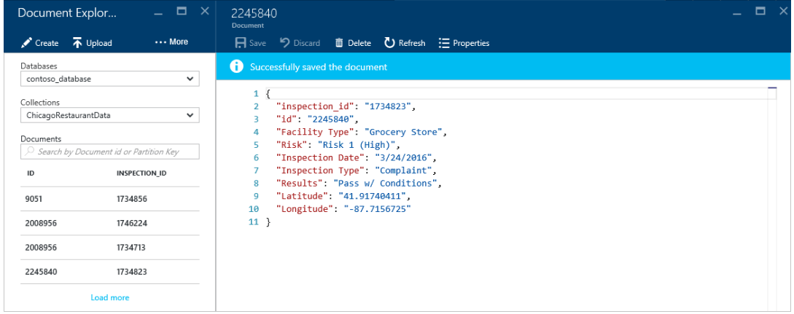
Document Explorer
Notes:
The Document Explorer is a tool located within the Azure Cosmos DB blade in the Azure Portal that allows you to view, modify and add documents to your Azure Cosmos DB collection. Within the explorer, you can upload one or more JSON documents directly into a specific database or collection.

Slide 17
Data Migration Tool
JSON files
MongoDB
SQL Server
CSV files
Azure Table storage
Amazon DynamoDB
HBase
Azure Cosmos DB collections
https://azure.microsoft.com/en-us/updates/documentdb-data-migration-tool/
Notes:
The open-source Azure Cosmos DB data migration tool (https://github.com/azure/azure-documentdb-datamigrationtool) allows you to import data into a Azure Cosmos DB database and collection from various sources including:

Slide 18
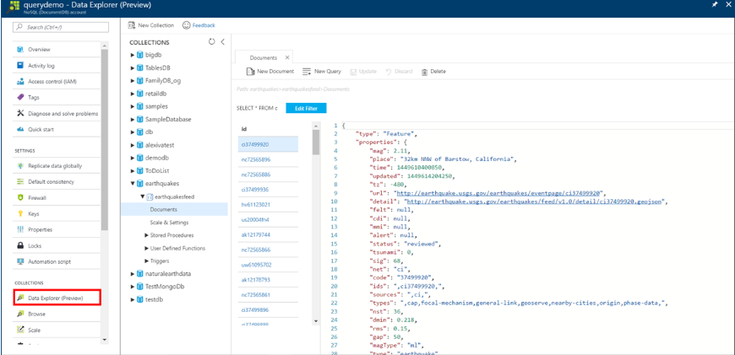
Data Explorer
https://azure.microsoft.com/en-us/updates/documentdb-data-explorer-preview-now-available-in-the-azure-portal/
Notes:
Data Explorer, now in preview, provides a rich and unified developer experience for inserting, querying, and managing Azure Cosmos DB data within the Azure portal and the Emulator.
Data Explorer consolidates many of the database management tools available in the Azure Cosmos DB portal, such as Document Explorer, Query Explorer, and Script Explorer, so that they can all be done without switching blades. Data Explorer is a one-stop shop for management of your Azure Cosmos DB data.

Slide 19
Implement event-driven applications by using Azure functions, triggers and Cosmos DB change feed
Use Cosmos DB triggers for Azure functions
Change feed mechanics

Slide 20
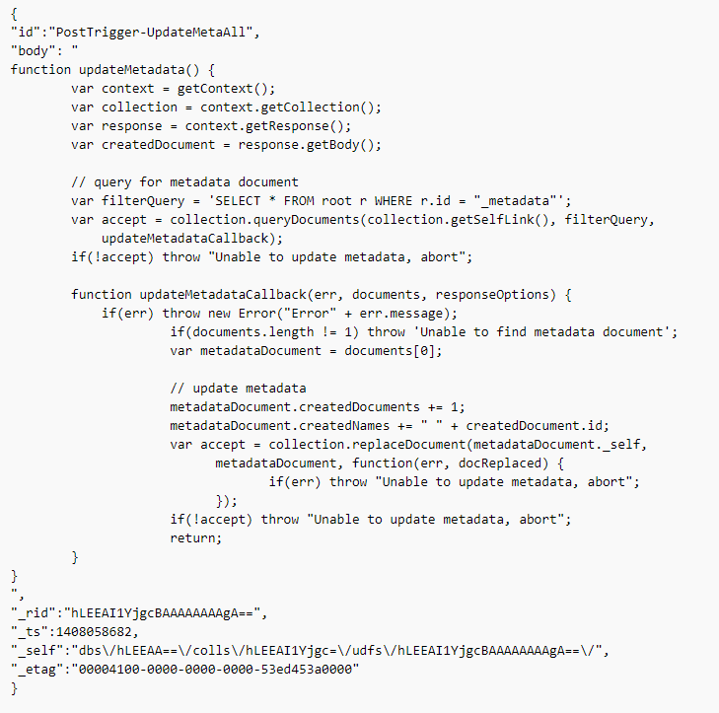
Triggers
https://docs.microsoft.com/en-us/rest/api/cosmos-db/triggers
Notes:
Triggers are pieces of application logic that can be executed before (pre-triggers) and after (post-triggers) creation, deletion, and replacement of a document. Triggers are written in JavaScript. Both pre and post triggers do no take parameters. Like stored procedures, triggers live within the confines of a collection, thus confining the application logic to the collection.
Similar to stored procedures, the triggers resource has a fixed schema.

Slide 21
Change Feed

Slide 22
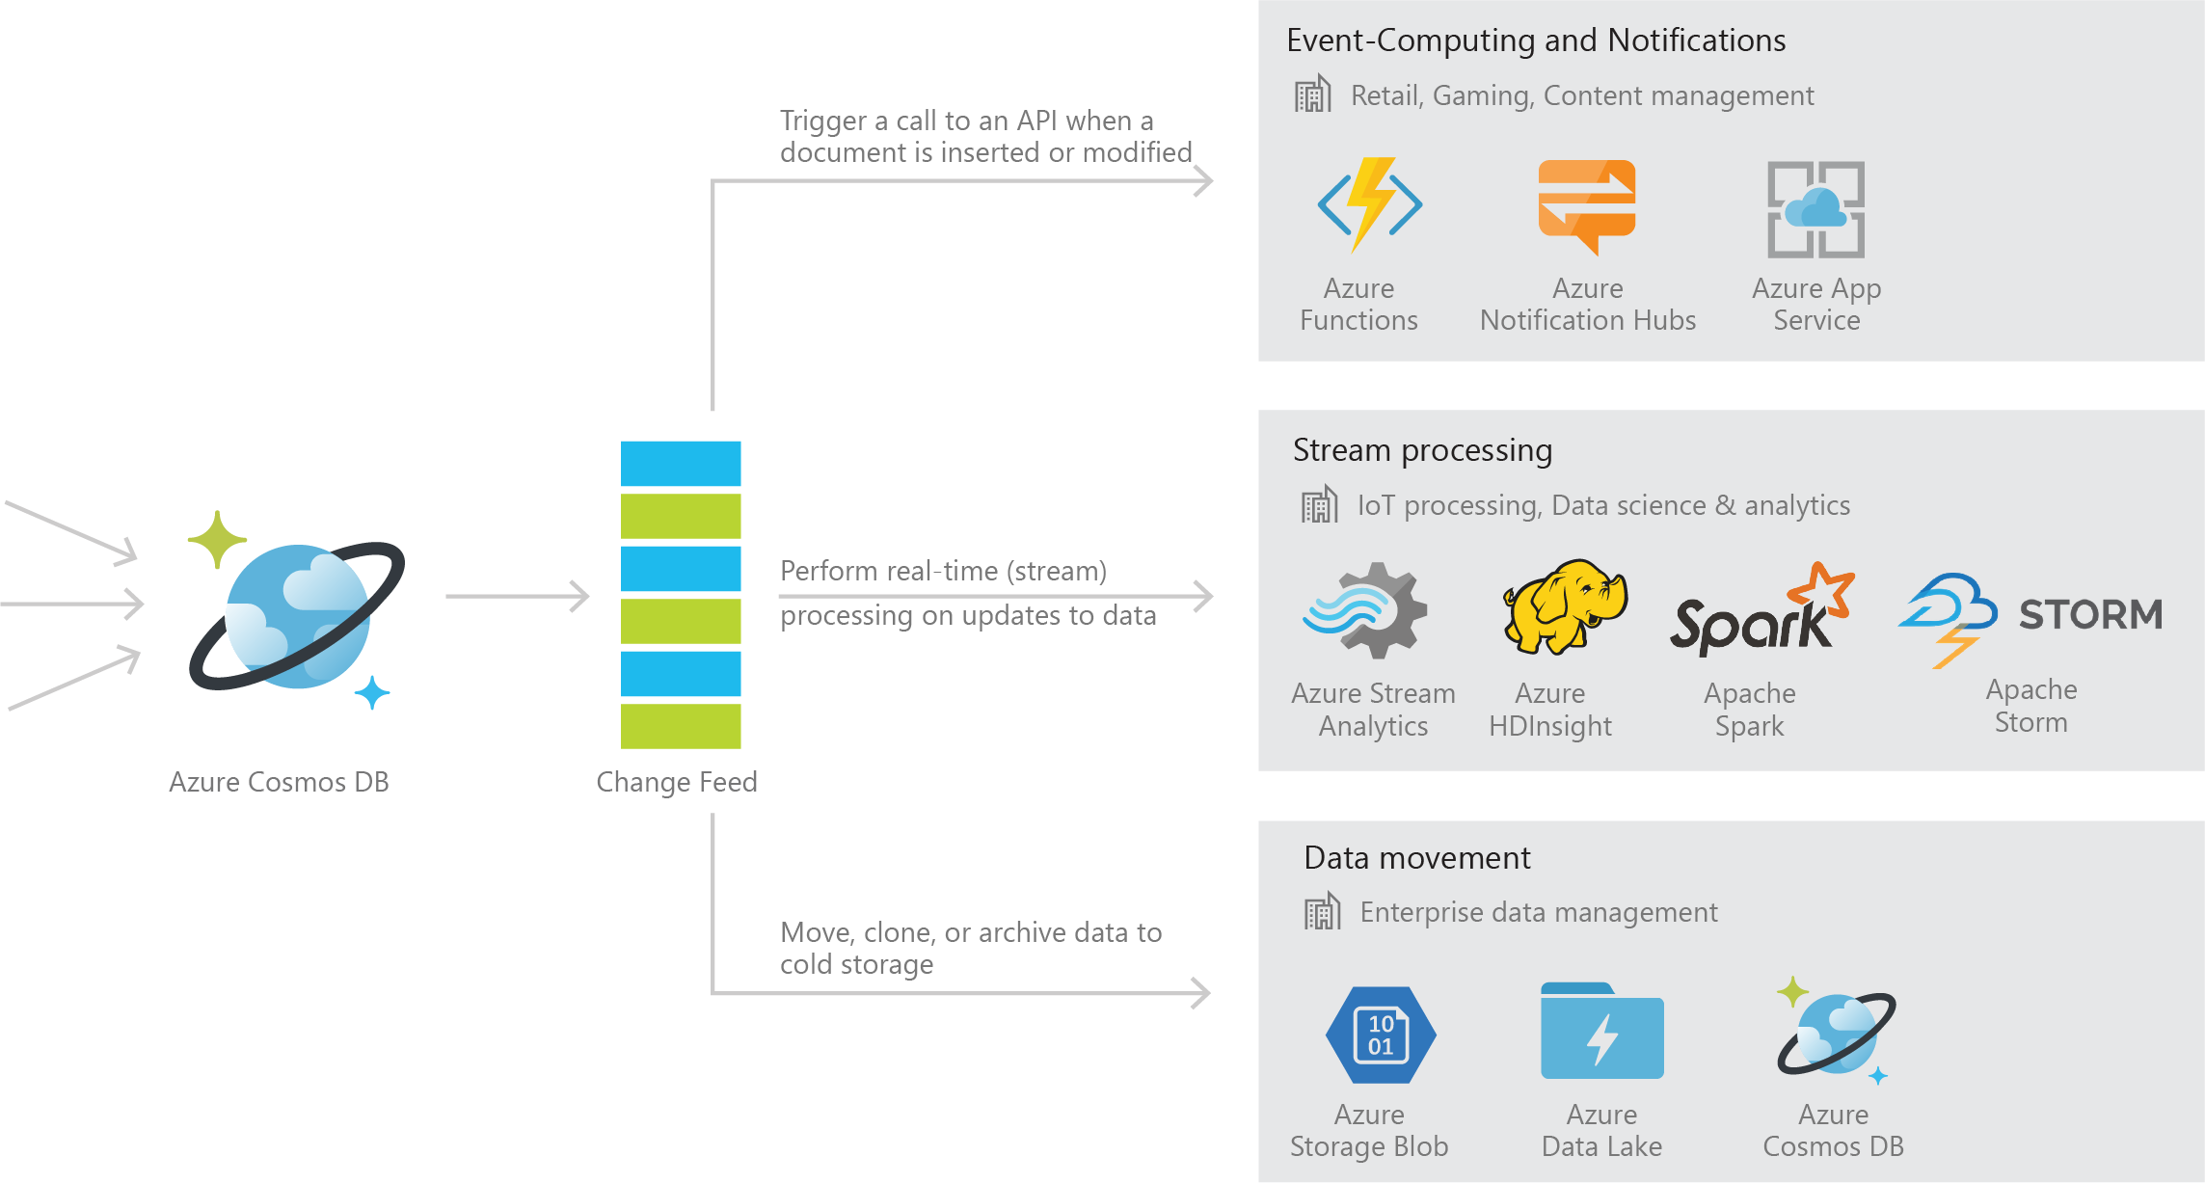
Azure Cosmos DB Change Feed
Persistent log of records within an Azure Cosmos DB container in the order in which they were modified
https://docs.microsoft.com/en-us/azure/cosmos-db/change-feed
Notes:
An event of the full record is in the event feed record

Slide 23
Common Scenarios

Slide 24


Event Sourcing for Microservices
Trigger Action From Change Feed
Persistent Event Store
Microservice
#1
Microservice #2
New Event
…
Microservice #N

Slide 25
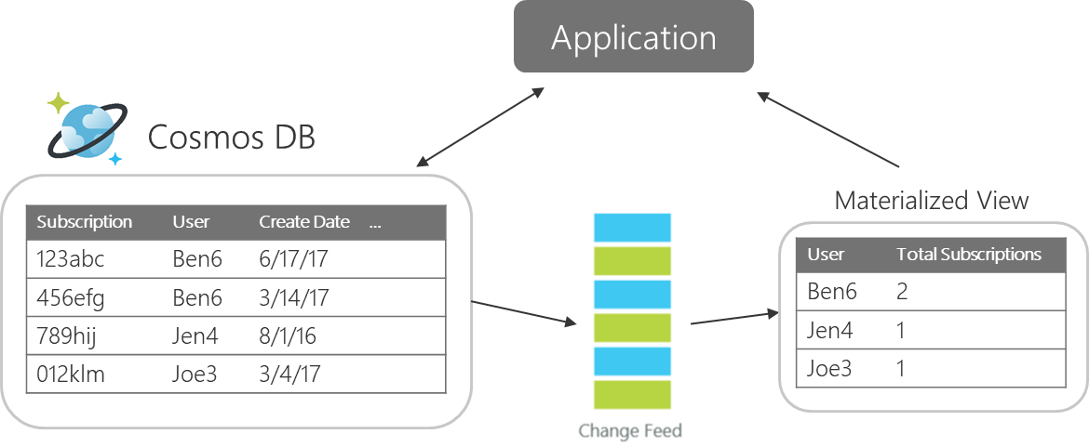
Materializing Views

Slide 26
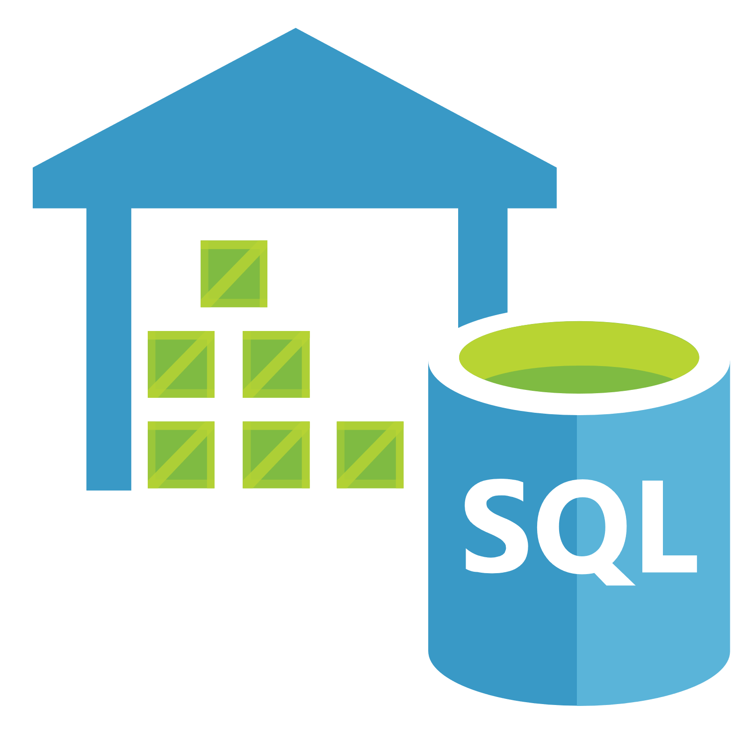

Replicating Data
Secondary Datastore (e.g. archive)
Replicate Records
CRUD Data

Slide 27
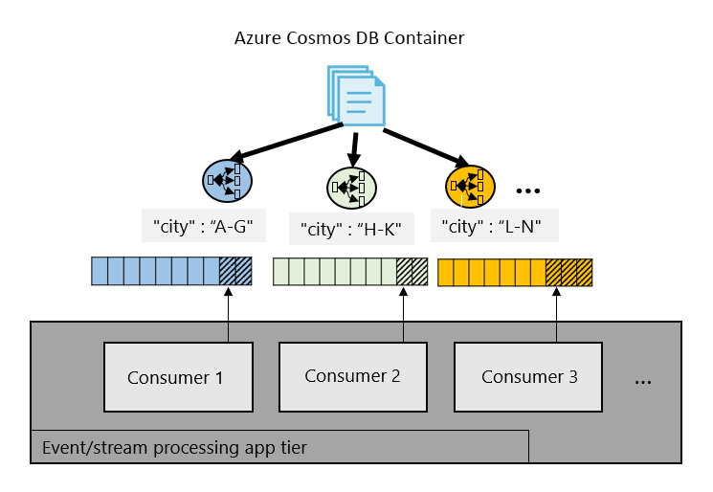
Working with Change Feed

Slide 28
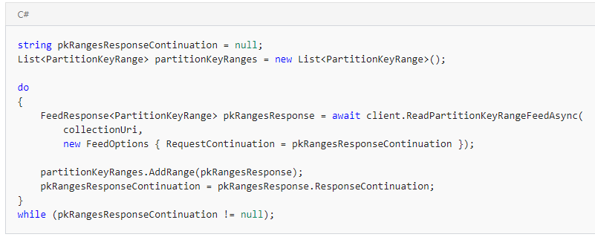
Working with Change Feed
Step 1: Retrieve a list of the partition key ranges

Slide 29
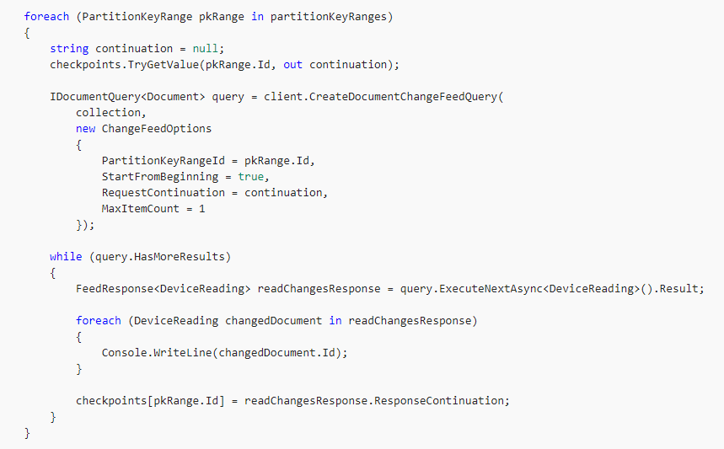
Working with Change Feed
Step 2: Consume the Change Feed on each PartitionKeyRange

Slide 30
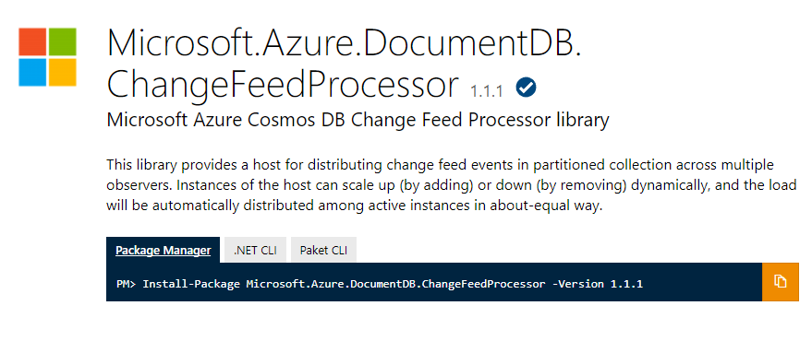
Change Feed Processor Library

Slide 31
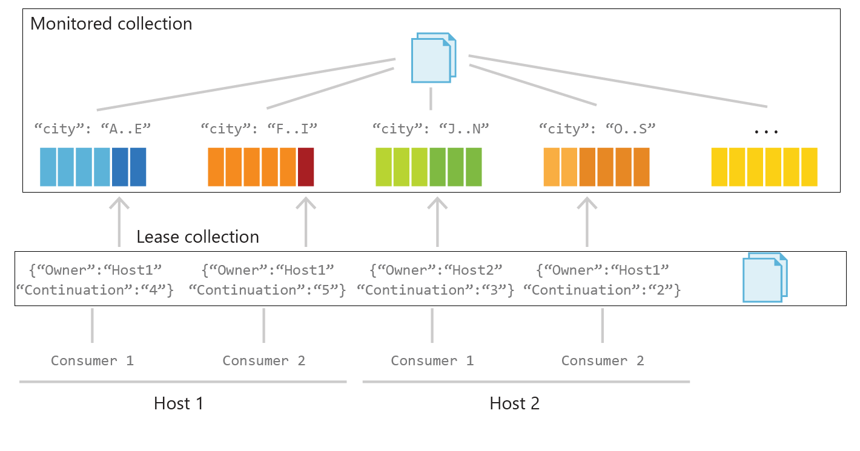
Behind the Scenes

Slide 32
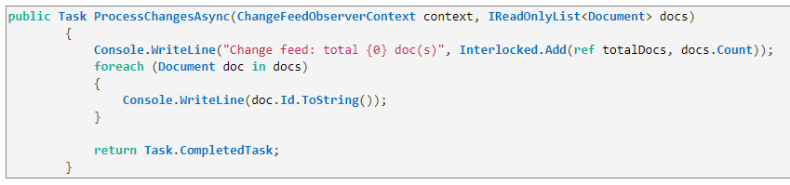
Working with Change Feed Processor Library
Step 1: Implement ProcessChangesAsync() on IChangeFeedObserver

Slide 33
Working with Change Feed Processor Library
Step 2: Register the IChangeFeedObserver with to a ChangeFeedEventHost

Slide 34
Analyze Cosmos DB data with Apache Spark connector
Set up and configure a Cosmos DB Spark connector
Push down predicates

Slide 35
Azure Cosmos DB + Spark include
Streaming Extract, Transformation, and Loading of data (ETL)
Data enrichment
Trigger event detection
Complex session analysis and personalization
Visual data exploration and interactive analysis
Notebook experience for data exploration, information sharing, and collaboration
https://docs.microsoft.com/en-us/azure/cosmos-db/spark-connector
Notes:
The Spark to Azure Cosmos DB connector enables Azure Cosmos DB to act as an input source or output sink for Apache Spark jobs. Connecting Sparkto Azure Cosmos DB accelerates your ability to solve fast-moving data science problems where you can use Azure Cosmos DB to quickly persist and query data. The Spark to Azure Cosmos DB connector efficiently utilizes the native Azure Cosmos DB managed indexes. The indexes enable updateable columns when you perform analytics and push-down predicate filtering against fast-changing globally distributed data, which range from Internet of Things (IoT) to data science and analytics scenarios.

Slide 36
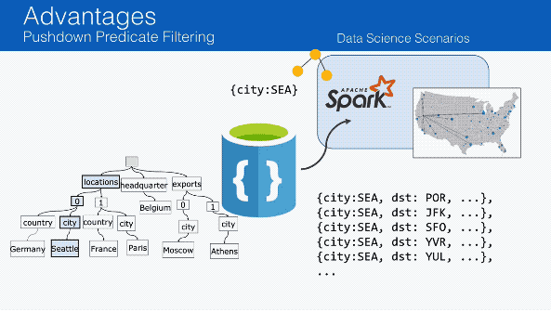
Push down predicates
https://github.com/Azure/azure-cosmosdb-spark/wiki
Notes:
For example, if you only want to ask for the flights departing from Seattle (SEA), azure-cosmosdb-spark will:
Send the query to Azure Cosmos DB
As all attributes within Azure Cosmos DB are automatically indexed, only the flights pertaining to Seattle will be returned to the Spark worker nodes quickly.
This way as you perform your Data Sciences work, you will only transfer the data you need.

